Slide 1
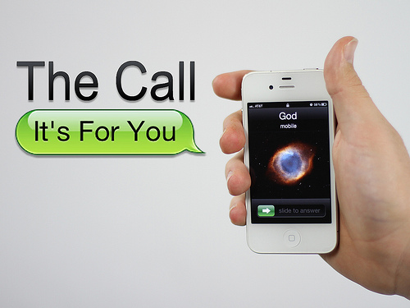

Slide 2

Romans 8:28
New International Version
“We know that in all things God works for the good of those who love Him, who have been called according to His purpose.”

Slide 3
Romans 8:30
New International Version
“Those God predestined, He also called; and those He called, He also justified; and those He justified, He also glorified.”

Slide 4
Ephesians 1:18-19
Contemporary English Version
“My prayer is that light will flood your hearts and that you will understand the hope that was given to you when God CALLED YOU. Then you will discover the glorious blessings that will be yours together with all of God’s people!”

Slide 5

THE CALL
1.
God called me before
I was born!

Slide 6
Galatians 1:15
New Living Translation
“It pleased God in His kindness to choose me and call me, even before I was born! What undeserved mercy!”

Slide 7
Jeremiah 1:5
Message
“Before I shaped you in the womb, I knew all about you. Before you saw the light of day, I had holy plans for you.”

Slide 8
Isaiah 44:2
“I am your Creator. You were in my care even before you were born!”

Slide 9
THE CALL
2.
It is a gift from God!

Slide 10
Galatians 1:6
New Century Version
“God, by His grace through Christ, has called you to become His people.”

Slide 11
2 Timothy 1:9
New International Version
“He has saved us and called us to a holy life – not because of anything we have done but because of His own purpose and grace.”

Slide 12
THE CALL
3.
Called for God’s purpose!

Slide 13
Romans 9:11
New Century Version
“Before the two boys were born, God told Rebekah, ‘The older will serve the younger.’ This was before the boys had done anything good or bad. God said this so that the one chosen would be chosen because of God’s own plan. He was chosen because he was the one God wanted to call, not because of anything he did.”

Slide 14
Ephesians 2:10
New International Version
“For we are God’s workmanship, created in Christ Jesus to do good works, which God prepared in advance for us to do.”

Slide 15
THE CALL
4.
God empowers what
He calls me to do!

Slide 16
THE CALL
5.
My calling is permanent

Slide 17
Romans 11:29
New International Version
“God’s gifts and His calling are irrevocable.”

Slide 18
Romans 11:29
New Living Translation
“God’s gifts and His call can never be withdrawn.”

Slide 19
Ephesians 4:1
New Century Version
“I now urge you to live the life to which God called you.”

Slide 20
LEVELS OF THE CALL
Have communion with Christ
General callings (Called to Love, serve, forgive)
Specific calling

Slide 21
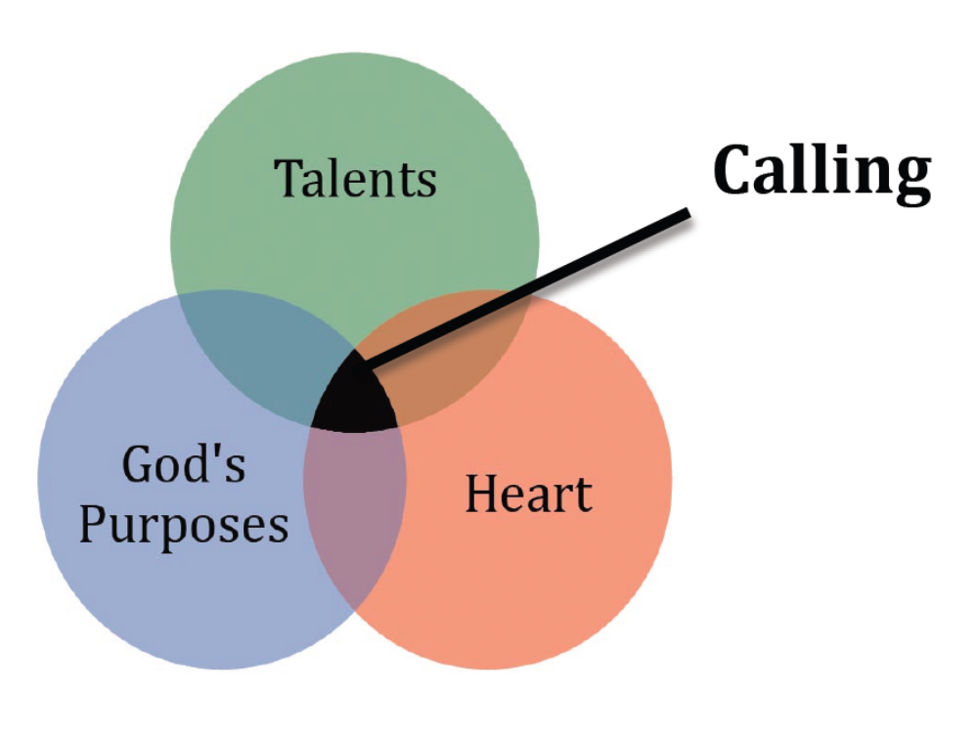

Slide 22
2 Thessalonians 1:11
New Century Version
“That is why we always pray for you, asking our God to help you live the kind of life He called you to live. We pray that with His power God will help you do the good things you want, and perform the works that come from your faith.”

Slide 23
1 Thessalonians 5:24
New International Version
“The one who calls you is faithful and He will do it.”

